Slide 1


Slide 2
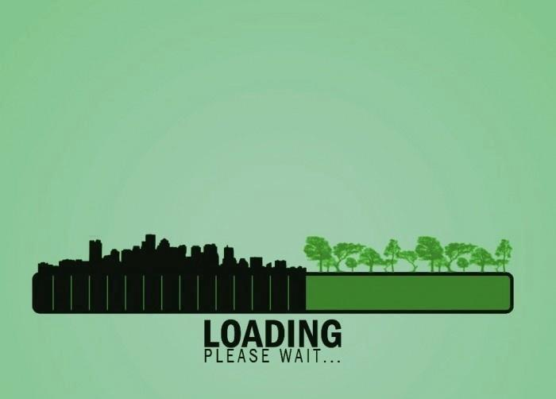
?

Slide 3

“ All Human Beings are in Danger
Because of Deforestation ”

Slide 4

“Death rate in Bangladesh is the highest all over the world due to air pollution”

Slide 5

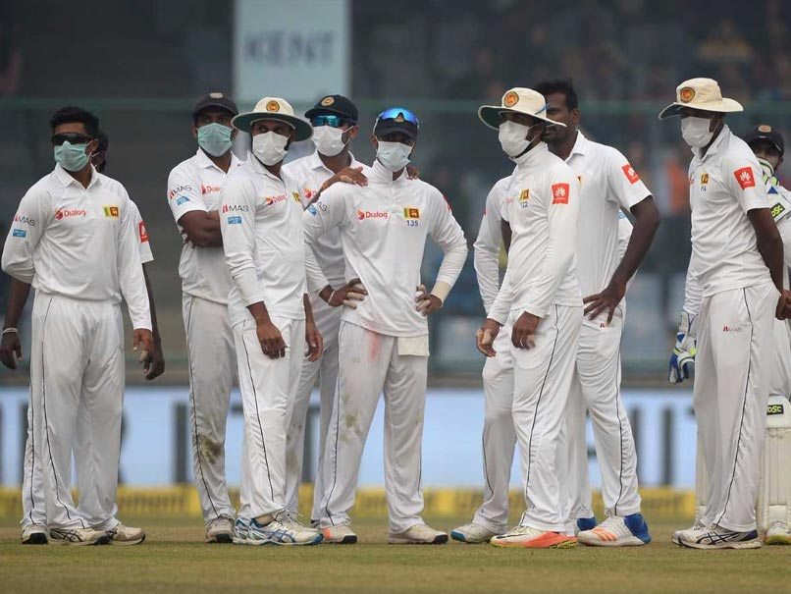
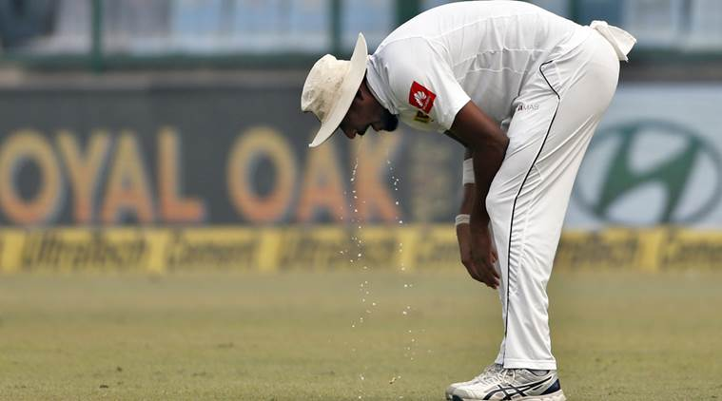
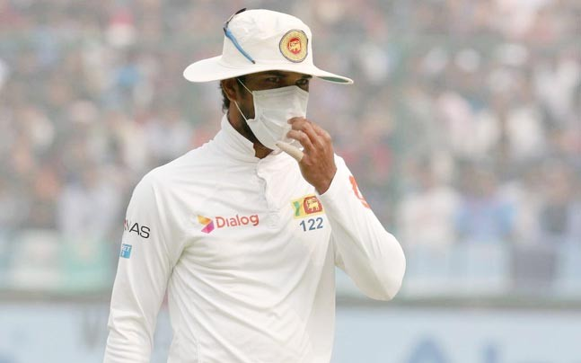
Recent Example

Slide 6
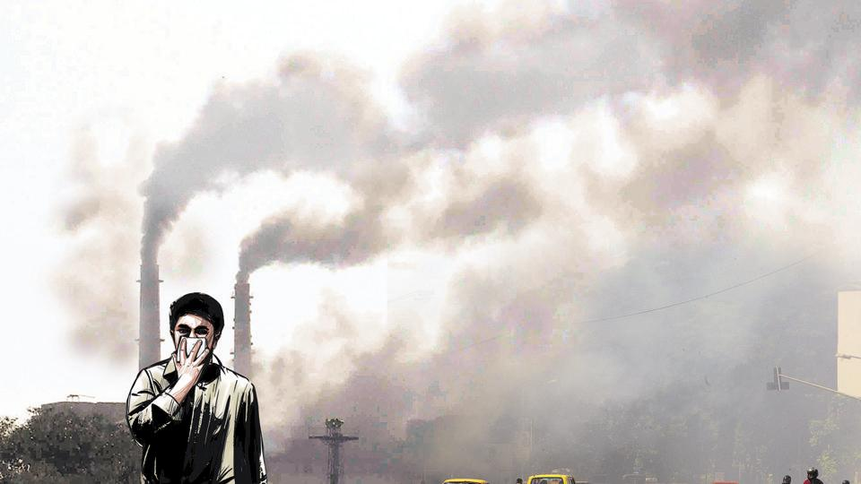

Every 1 out of 8 deaths
in the world is due to
air pollution
(WHO-2014)

Slide 7
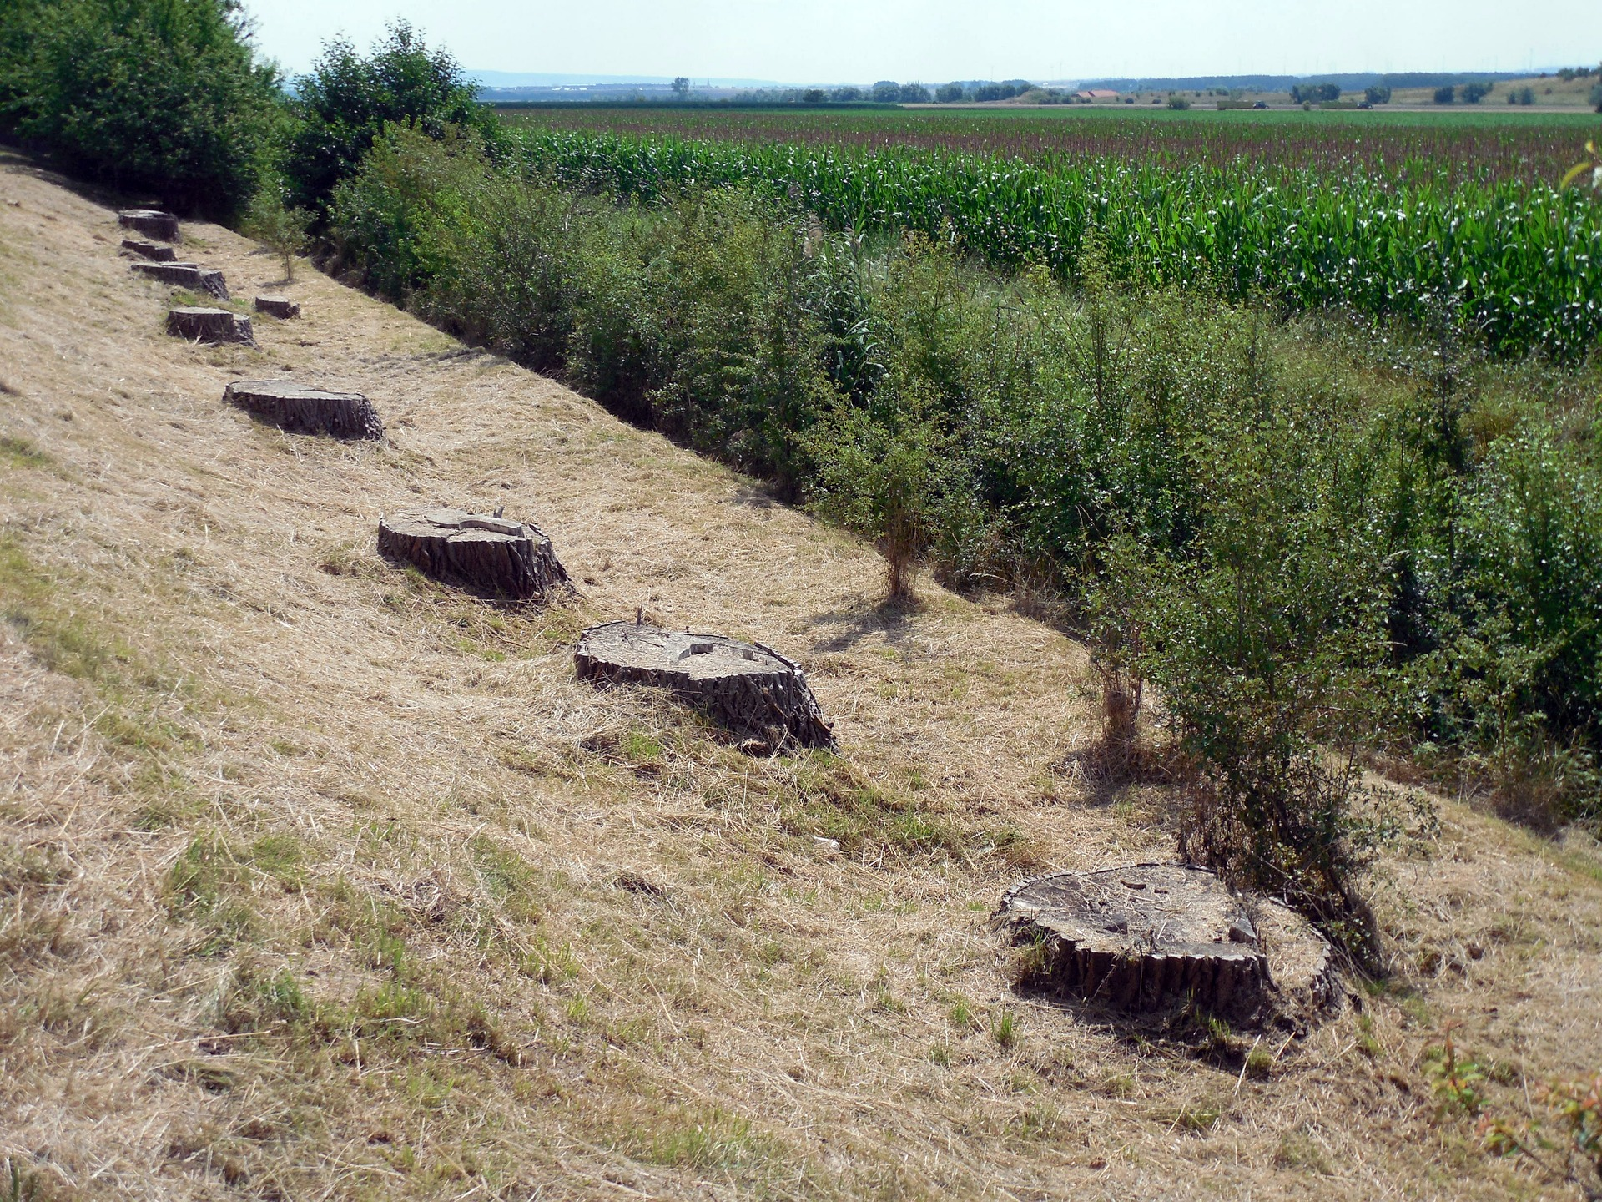
Global Statistics
Almost 50,000 sq. miles of forest lost/year
Amazon lost around 17% of the forest in the last 50 years
Rate of deforestation = 20 football fields/minute.
Estimated that there will be no rainforest within 100 years.

Slide 8
Statistics in Bangladesh
50% forests destroyed in last 20 years
Almost 1.2 lakhs people die per year due to air pollution
8.5 million peoples are attacked by asthma and 7.5 are bronchitis
24% students are facing lungs problem

Slide 9

Where will you plant tree
???

Slide 10


Slide 11
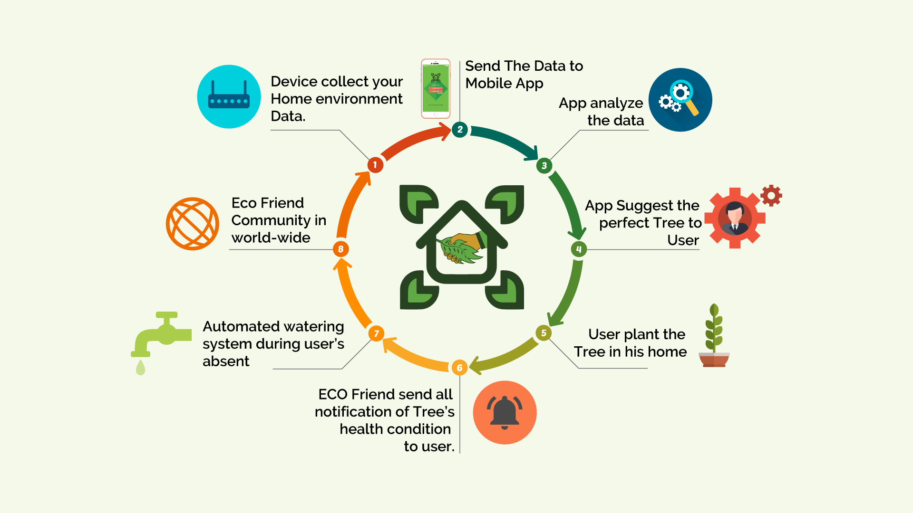
How Eco friend Works

Slide 12
Device Type
Home device
Area Based Device

Slide 13
Business Plan
1st year:
(I) Create social awareness
(ii) Make and sell 5000 product.
(iii) 25 lakhs profit.
2nd year:
(I) Reach more cities in Bangladesh
(ii) Get government involvement.
3rd year:
(I) Sell our product in India
(ii) Enter global market

Slide 14


Slide 15


